Slide 1
Cross-Lingual Document Retrieval, Categorisation and Navigation Based on Distributed Services
http://clarity.shef.ac.uk/

Slide 2

CLARITY Project
Main objectives:
  To develop CLIR techniques for English -> Finnish, Swedish, Latvian & Lithuanian i.e low density languages with minimal translation resources
  To investigate techniques of document organisation and presentation:
      concept hierarchies
      document genres & filters

Slide 3

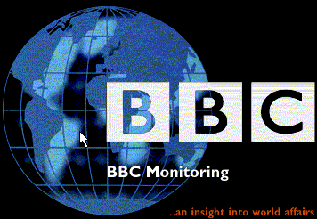



Project Partners
The University of Sheffield, UK:
Project coordinator and developer of architecture, interface and concept hierarchies
AlmaMedia, Finland:
Finnish and Swedish text collections
The University of Tampere (Information Studies), Finland:
Developer of information retrieval engine and linguistic tools for Finnish language
BBC Monitoring, UK
Swedish Institute of Computer Science:
Developer of document styles and filtering software
CIIR, Univ. of Massachusetts, USA:
Research collaborator
Tilde SIA, Latvia:
Developer of tools and resources for Baltic languages

Slide 4
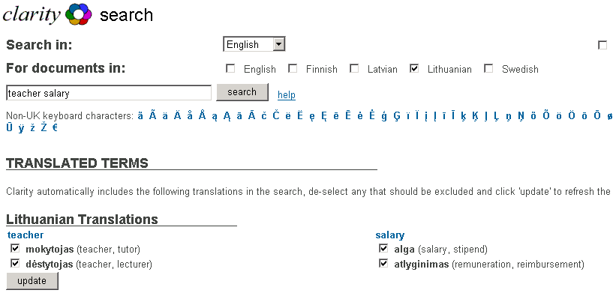

Slide 5
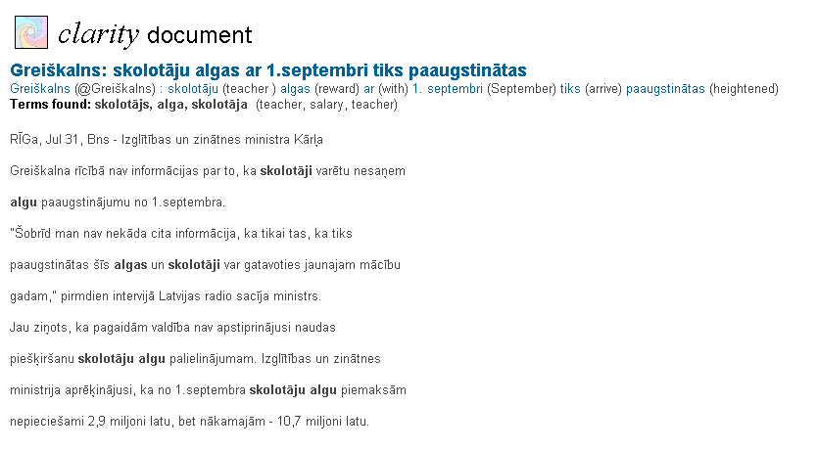
Document Presentation: Text View
Source
search
terms
Translated
title
Target
search terms
(highlighted)

Slide 6
Document Presentation: Concept Hierarchies
An effective method of organising a set of documents without prior knowledge or training data
Task: organise target language documents into clusters of source language concepts (requires translation of target language terms)

Slide 7
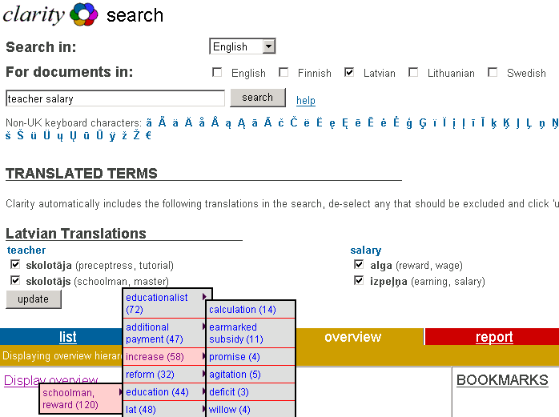
CLIR and Concept Hierarchies

Slide 8
Translation Routes
10 direct routes (all routes between Fin/Swe/Eng; English <-> Lat / Lit).
Transitive: Finnish->English->Latvian; Latvian->English->Lithuanian,
Triangulated: Finnish->Latvian via two pivots: Finnish->English->Latvian and Finnish->German ->Latvian

Slide 9
Results for Baltic Languages
Monolingual, cross-lingual and triangular cross-lingual IR system
Triangular CLIR is efficient method for IR between low density languages
Concept hierarchies allows organize cross‑language documents more effectively
Headline translations allows user evaluate relevance of foreign document
Notes:
1) We know people are really good at assessing document worth - we are
both fast and consisten. We don't know how they do it. We know we look
at many many each in themselves uninteresting factors when we make the
judgments whether to read a document or not.
2) Digital document handling delivers documents in uniform. All files look
alike, and we have no recourse to patina, paper quality, etc etc etc. It is
more difficult to assess files than paper documents.
3) Styles add another dimension to document classification. Not orthogonal,
but somewhat divorced from topical categorization (which arguably is the
most important one). Styles indicate genres - consistent and understandable
stylistic categories such as legal text, fiction, poetry, abstract text,
letters etc etc etc. Genres are necessary, since stylistic variation along
a number of inthemselves uninteresting dimensions would not be easy to understand
for a reader.
4) Stylistic analysis can be done simply by computers by counting some simple
stylistic features: presence of lexical items, sentence length, etc.
5) Better analysis is useless if it cannot be presented to the user in some way.
6) This example interface (the underlying engine was altavista in the
example implementation) clusters documents by style into tentative genres
(columns) and topic (rows). It presents regular retrieval results not in a
list as altavista and google do but in a space of topic by genre. The words
in the leftmost column are a (not very good) multi-document summary. The
pretty bubbles indicate by their size the number of documents in each
category. They can be dragged to the recluster panel up on the right side,
and will then be reclustered topically. The genres are fixed (after
extensive user studies).

Slide 10
Conclusions
Clarity is to our knowledge the only CLIR system that has support for Baltic languages
The web services architecture allowed us to utilise local linguistic expertise, to avoid re-installing and maintaining software versions on different platforms and to deal with data licensing issues
The results show that CLIR can be performed with the use of dictionaries without the need of ‘translation-rich’ methods
Triangulated translation via pivot languages can be a solution when there is no translation dictionary between source and target language
Notes:
1) We know people are really good at assessing document worth - we are
both fast and consisten. We don't know how they do it. We know we look
at many many each in themselves uninteresting factors when we make the
judgments whether to read a document or not.
2) Digital document handling delivers documents in uniform. All files look
alike, and we have no recourse to patina, paper quality, etc etc etc. It is
more difficult to assess files than paper documents.
3) Styles add another dimension to document classification. Not orthogonal,
but somewhat divorced from topical categorization (which arguably is the
most important one). Styles indicate genres - consistent and understandable
stylistic categories such as legal text, fiction, poetry, abstract text,
letters etc etc etc. Genres are necessary, since stylistic variation along
a number of inthemselves uninteresting dimensions would not be easy to understand
for a reader.
4) Stylistic analysis can be done simply by computers by counting some simple
stylistic features: presence of lexical items, sentence length, etc.
5) Better analysis is useless if it cannot be presented to the user in some way.
6) This example interface (the underlying engine was altavista in the
example implementation) clusters documents by style into tentative genres
(columns) and topic (rows). It presents regular retrieval results not in a
list as altavista and google do but in a space of topic by genre. The words
in the leftmost column are a (not very good) multi-document summary. The
pretty bubbles indicate by their size the number of documents in each
category. They can be dragged to the recluster panel up on the right side,
and will then be reclustered topically. The genres are fixed (after
extensive user studies).

